Slide 1
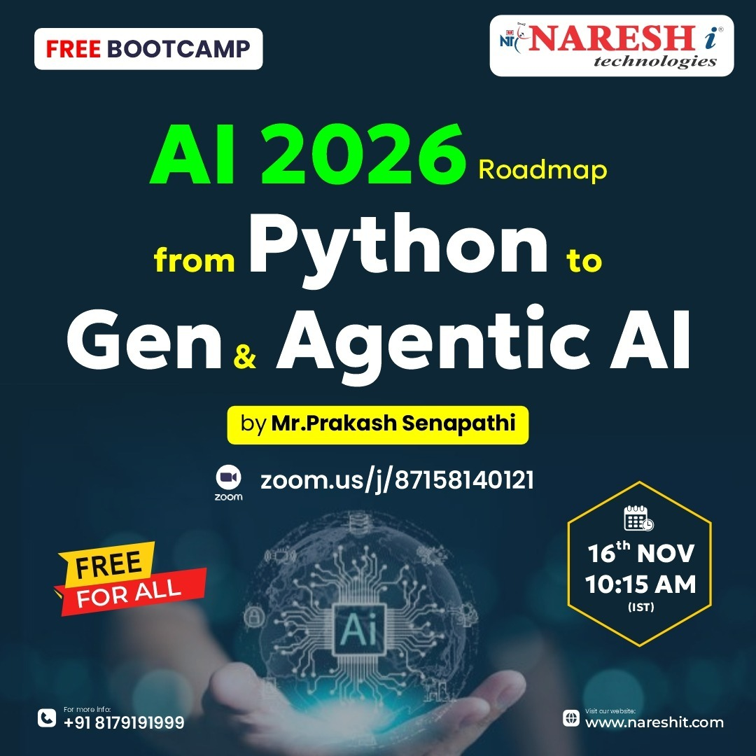
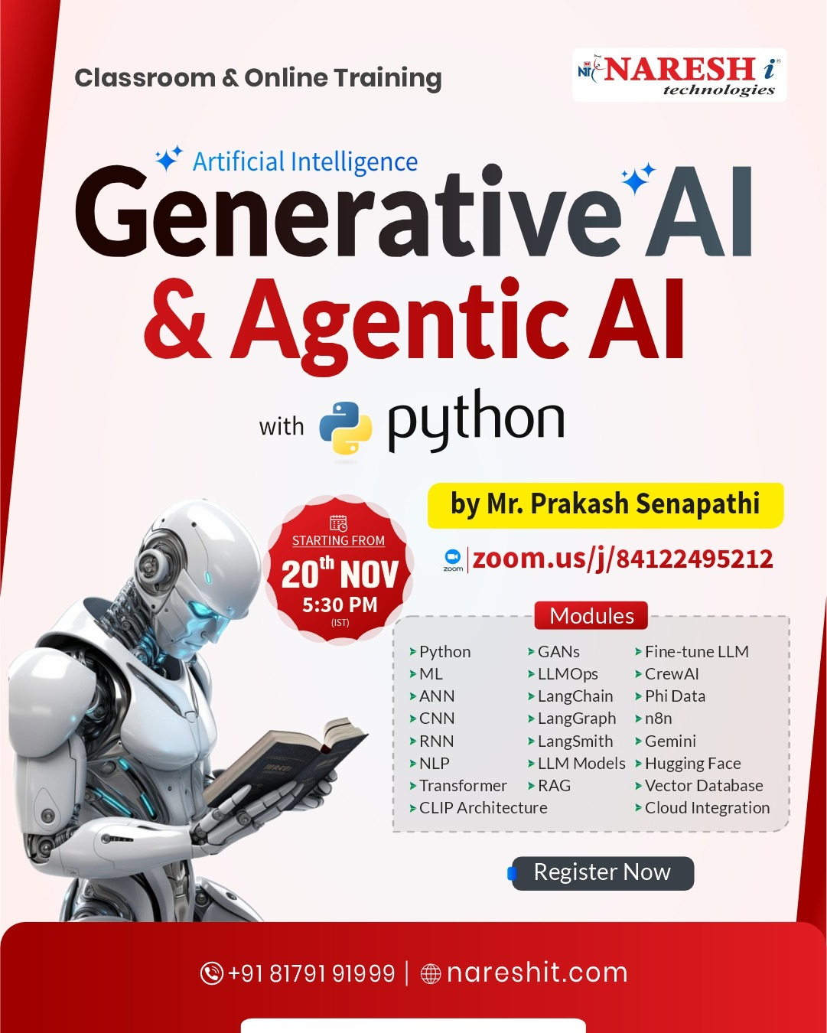

Slide 2
2026 Roadmap for Advanced ML, AI, Generative AI, Agentic AI with Python
AI Expert -- K. Prakash Senapati
Linked In -- https://www.linkedin.com/in/kodi-prakash-senapati-a95a60182/
Portfolio -- https://kodigitaccount.github.io/kodigithub.io/

Slide 3

Module List
Module:1 - Python
Module:2 - EDA & machine learning
Module:3 - Artificial Intelligence
Module:4 - Natural Language Processing
Module:5 - Deep Learning | Neural Network
Module:6 - Generative AI
Module:7 - LLM (Large Language Model)
Module:8 - Prompt Engineering
Module:9 - RAG ( Retriever Augmented Generation)
Module:10 - Agentic AI
Module:11 - MCP (Model Context Protocol)
Module:12 – Capstone Projects
Module:13 – Resume Preparation
Module:14 – AI tool Mock Interview

Slide 4
YOUTUBE PLAYLIST
1. Agentic AI è playlist?list=PLVlQHNRLflP8Pt3wVlRWRaXZXi79cIwSq
2. N8N Bootcamp --> https://www.youtube.com/watch?v=7iiwSKjKbRA&t=7054s
3. Hugging Face Bootcamp --> https://www.youtube.com/watch?v=QSWFG7Rj9c4&t=7646s
4. Data Analytics & Business Analytics è
playlist?list=PLVlQHNRLflP-BgYmMlM8YQpvQM2J99HE0 5. Generative AI è playlist?list=PLVlQHNRLflP81c99eg7UhkVZxwPvhTddM 6. Software Installation & Introduction to Python for Datascience è playlist?list=PLVlQHNRLflP9GN5rc8sBWnrV53DWAzfdn 7. AZUR AI (Cognitive Services for Data Scientist) è
playlist?list=PLVlQHNRLflP8JthpjvJFaofUkJS1A7qa1
8. Resume Building Bootcamp for Data Analytics, BA, Data Science & GEN AI Roles è playlist?list=PLVlQHNRLflP-SaPff3325gkISMHEznEix

Slide 5

New Batch Announcement
Generative AI & Agentic AI with Python @ 5:30 PM (IST) by Mr. Prakash Senapati From 20th November
Webinar Link: https://zoom.us/j/84122495212
Registration Link: https://us06web.zoom.us/webinar/register/WN_qn0STmrAR4uppU_FoO04gA
Connect to Mr. Areef @ +91 - 9154861173

